Slide 1
1
2
3
1
2
3
4
1
2
3
4
1
2
3
4
1
2
3
4

Slide 2
1
2
3
4
1
2
3
4
1
2
3
1
2
3
4
1
2
3
4

Slide 4
Lane No. | 1 | 2 | 3 | 4 | 5 | 6 | 7 | 8 | 9 | 10 | 11
Reaction Time [min] | 1 | 2 | 5 | 10 | 12 | 15 | 20 | 25 | 30 | 60 | 100
Lane No. | 1 | 2 | 3 | 4 | 5 | 6 | 7 | 8 | 9 | 10 | 11 | 12
Reaction Time [min] | 1 | 2 | 5 | 10 | 12 | 15 | 20 | × | 25 | 30 | 60 | 100
Transducer A
Transducer A
Output A
Output A

Slide 5
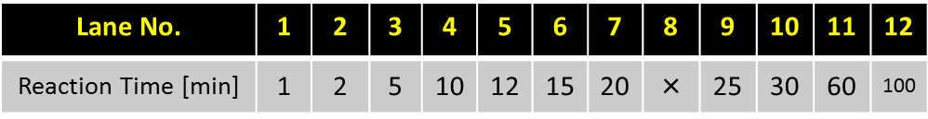
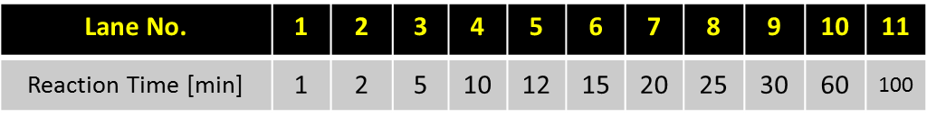
Transducer A
Transducer A
Output A
Output A

Slide 6
Output B
Output B
Output A
Output A

Slide 7
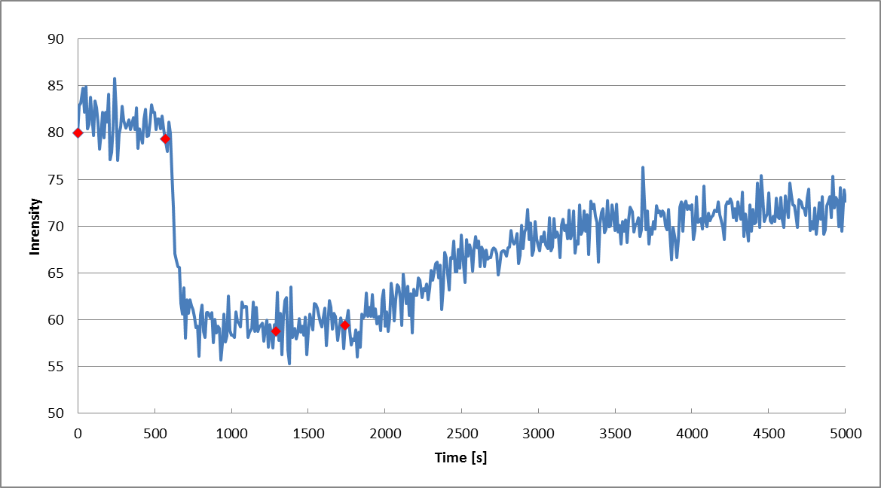
mO
+ mO*
+ I - I*
+ Trigger

Slide 9
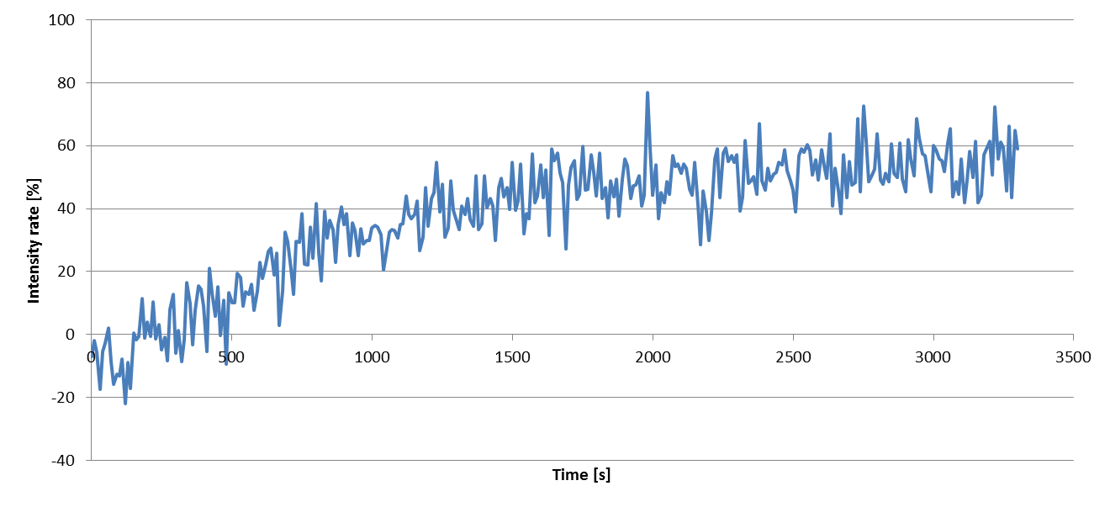

Slide 11
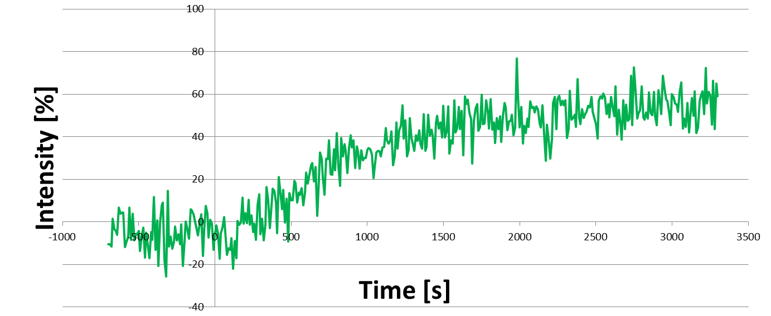

Slide 12
1
2
3
Input & Template complex
Input
Template
Key Strand

Slide 13
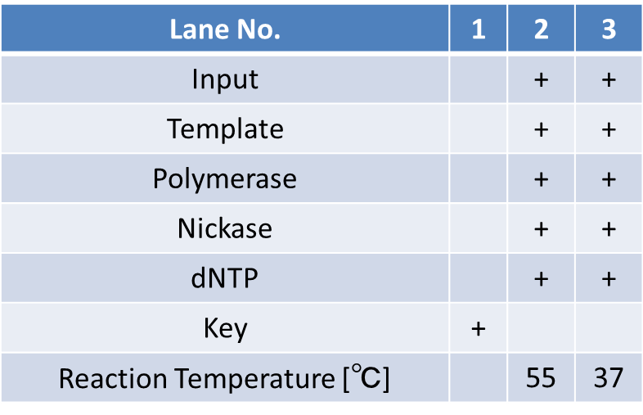
Input & Template complex
Input
Template
Key Strand
Notes:
表はコピーして図として貼り付けた後にグループ化しましょうBy今井

Slide 14
Lane No. | 1 | 2 | 3
Input |  | + | +
Template |  | + | +
Polymerase |  | + | +
Nickase |  | + | +
dNTP |  | + | +
Key | +
Reaction Temperature [℃] |  | 55 | 37
Input & Template complex
Input
Template
Key Strand
Notes:
表はコピーして図として貼り付けた後にグループ化しましょうBy今井

Slide 15
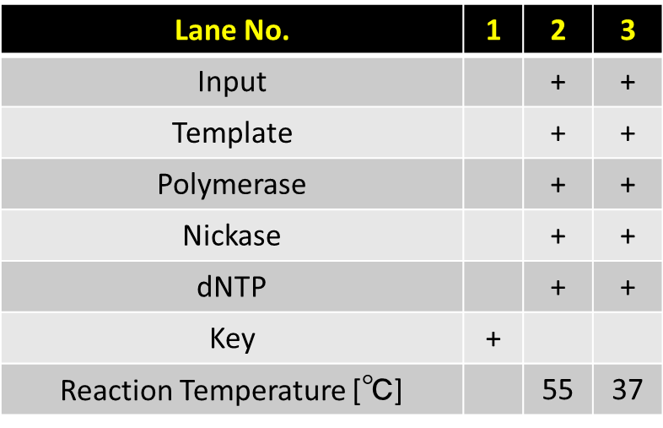
Input & Template complex
Input
Template
Key Strand
Notes:
表はコピーして図として貼り付けた後にグループ化しましょうBy今井

Slide 16
Lane No. | 1 | 2 | 3
Output | + | + | +
Holder | + | + | +
Polymerase | + | + | +
dNTP | + | + | +
Signal |  | + | +
Reaction Temperature [℃] | 45 | 45 | 37
Input/Template complex
Signal

Slide 17
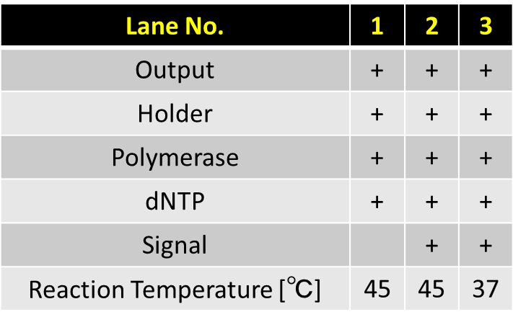
Input/Template complex
Signal

Slide 18
Lane No. | 1 | 2 | 3
Other components | + | + | +
Reaction Temperature [℃] | 45 | 45 | 37
Signal |  | + | +
Input/Template complex
Signal

Slide 19
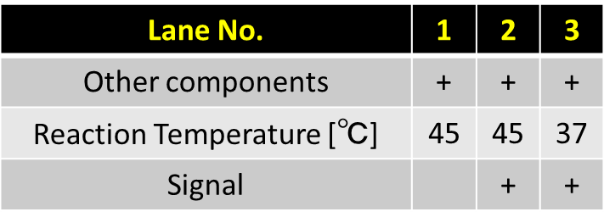
Input/Template complex
Signal

Slide 20
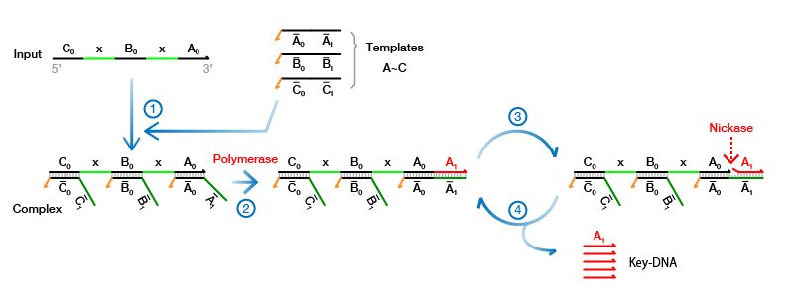

Slide 21
1
2
3
4
Anchor & Output
Waste
Output Strand
Output Strand

Slide 22
1
2
3
4
Anchor & Output
Waste
Output Strand
Output Strand

Slide 23
1
2
3
4
Anchor & Output
Waste
Output Strand
Output Strand

Slide 24
Lane No. | 1 | 2 | 3 | 4
Anchor | + | + | + | +
Output |  | + | + | +
Polymerase |  | + | + | +
dNTP |  | + | + | +
Key |  |  | + | +
Reaction Temperature [℃] |  | 37 | 37 | 65
Anchor & Output
Waste
Output Strand
Output Strand

Slide 25
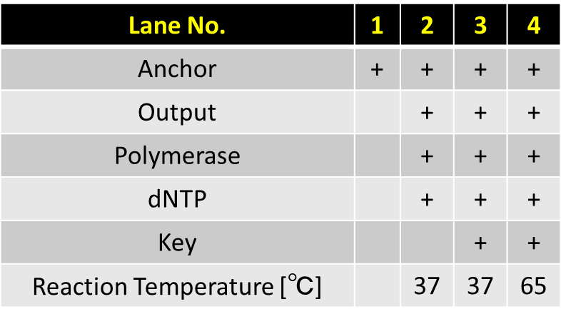
Anchor & Output
Waste
Output Strand
Output Strand

Slide 26
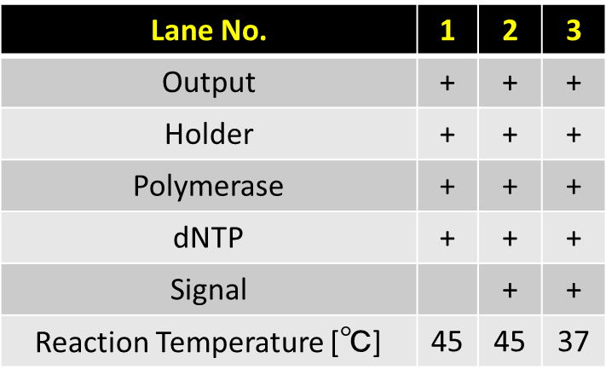
Waste
Output complex
Output Strand

Slide 27
Lane No. | 1 | 2 | 3
dNTP | + | + | +
Reaction Temperature [℃] | 45 | 45 | 37
Signal |  | + | +
Waste
Output complex
Output Strand

Slide 28

Waste
Output complex
Output Strand

Slide 29
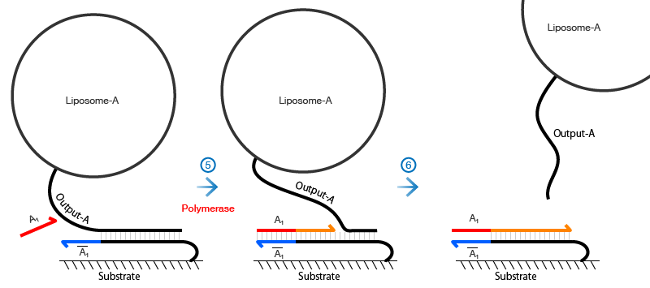
Waste

Slide 30
1
2
3
Gate
Fragment 1
Fragment 1
Fragment 2
Fragment 3

Slide 31
1
2
3
Gate complex
Fragment 1
Fragment 1
Signal
Next Complex
Fragment 2

Slide 32
1
2
3
Gate
Fragment 1
Fragment 1
Signal
Next Complex
Fragment 2 ssdna

Slide 33
Lane No. | 1 | 2 | 3
Input | + | + | +
Gate | + | +
Polymerase | + | +
dNTP | + | +
Key |  | +
Signal |  |  | +
EcoRI | + | + | +
Reaction Temperature [℃] | 45 | 45 | 45
Gate
Fragment 1
Fragment 1
Signal
Next Complex
Fragment 2 ssdna

Slide 34
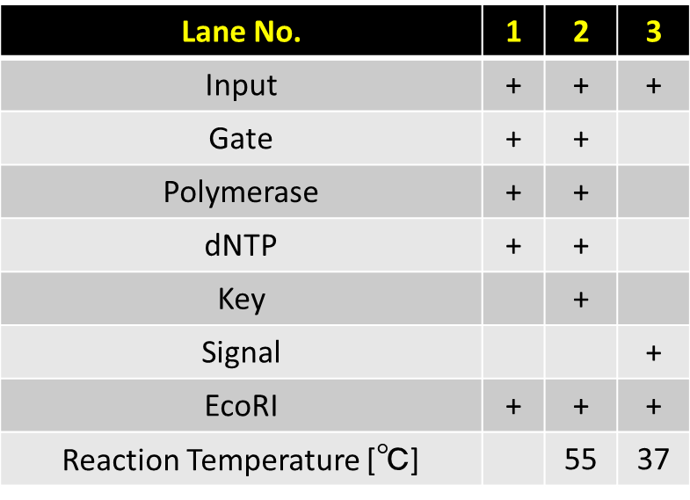
Gate
Fragment 1
Fragment 1
Signal
Next Complex
Fragment 2 ssdna

Slide 35
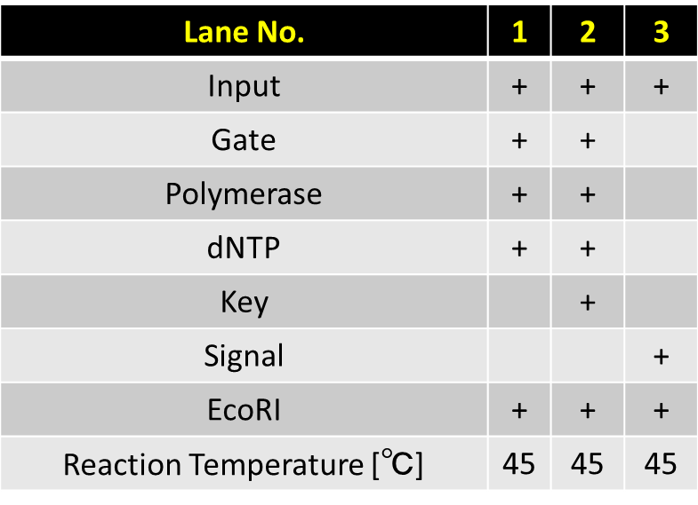
Gate complex
Fragment 1
Fragment 1
Signal
Next Complex
Fragment 2

Slide 36
Lane No. | 1 | 2
Input | + | +
Gate | + | +
Polymerase | + | +
dNTP | + | +
Signal |  | +
EcoRI | + | +
Reaction Temperature [℃] | 45 | 45
Updated Complex
Fragment

Slide 37
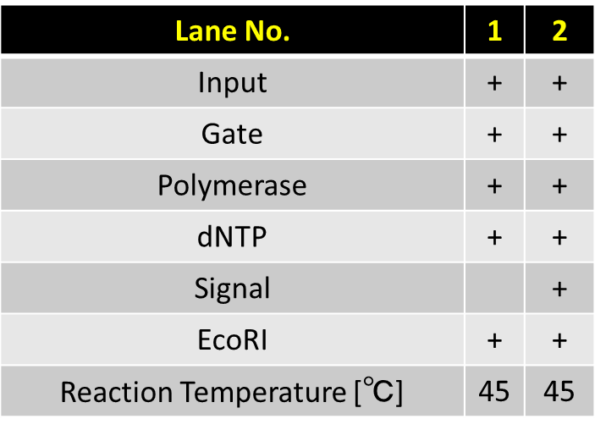
Updated Complex
Fragment

Slide 38
Lane No. | 1 | 2
Other components | + | +
Reaction Temperature [℃] | 45 | 45
Signal |  | +
Updated Complex
Fragment

Slide 39
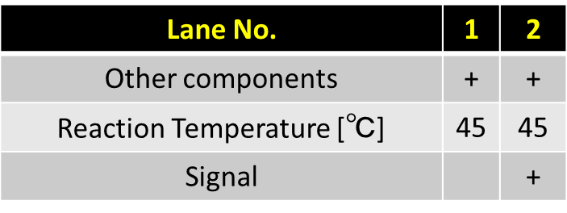
Updated Complex
Fragment

Slide 40
Lane No. | 1 | 2 | 3 | 4 | 5 | 6 | 7 | 8
Enzymes & dNTP | + | + | + | + | + | + | +
Output Complex | + | + | + | + | + | + | +
Output strand |  |  |  |  |  |  |  | +
Input/Template Complex |  | + | + | + | + | + | +
Reaction Time [min] |  | 1 | 2 | 5 | 10 | 20 | 50
Output Complex
Output Strand

Slide 41
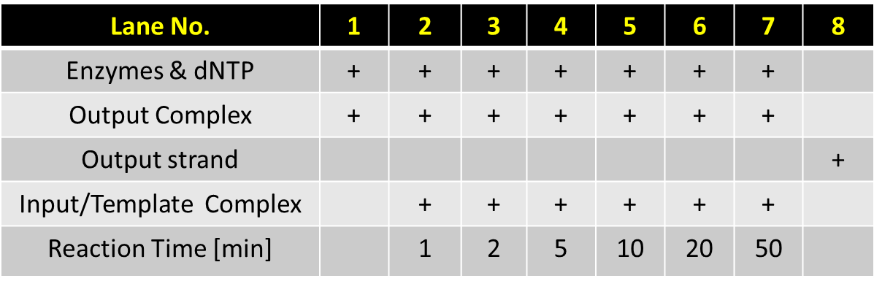
Output Complex
Output Strand

Slide 42
Signal

Slide 43
Signal

Slide 44
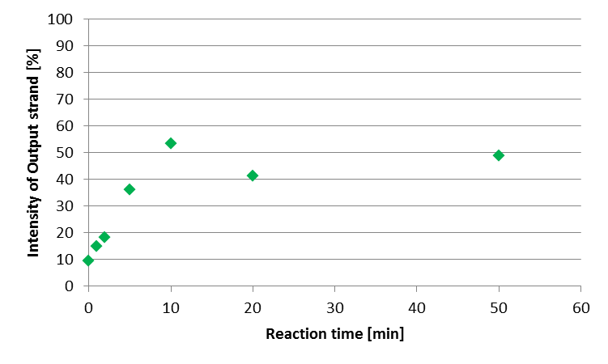
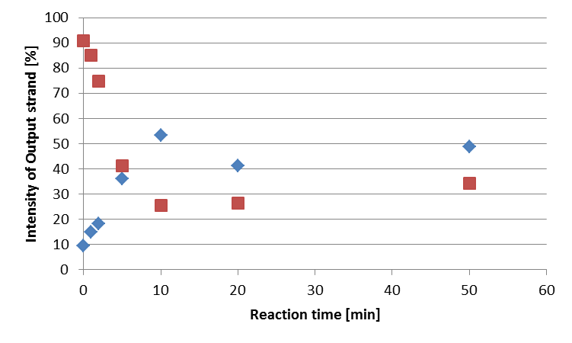

Slide 45
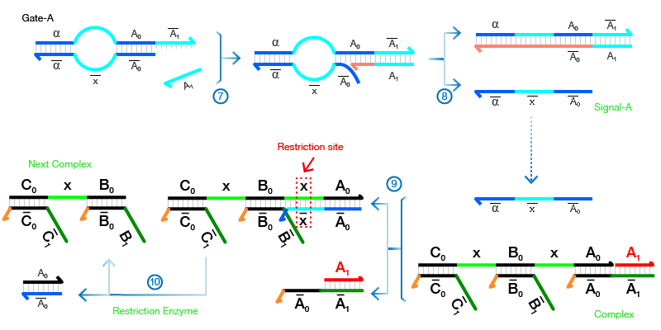

Slide 46
Fluorescence
Stained
1
2
3
4
1
2
3
4
Input &Input*
Output &Output*
Output Strand with FAM
Output with FAM &Output*
Output &Output*
Output Strand

Slide 47
Lane No. | 1 | 2 | 3 | 4
Anchor | + | + | + | +
Output |  | + | + | +
Polymerase |  | + | + | +
dNTP |  | + | + | +
Key |  |  | + | +
Reaction Temperature [℃] |  | 37 | 37 | 65
Lane No. | 1 | 2 | 3 | 4
Anchor | + | + | + | +
Output |  | + | + | +
Polymerase |  | + | + | +
dNTP |  | + | + | +
Key |  |  | + | +
Reaction Temperature [℃] |  | 37 | 37 | 65
Input &Input*
Output &Output*
Output with FAM &Output*
Output Strand with FAM
Output &Output*
Output Strand
Fluorescence
Stained

Slide 48
Lane No. | 1 | 2 | 3 | 4
Input Complex | + | + | + | +
Output Complex |  | + | + | +
Trigger |  | + | +
FAM modified Output |  | + |  | +
Lane No. | 1 | 2 | 3 | 4
Input Complex | + | + | + | +
Output Complex |  | + | + | +
Trigger |  | + | +
FAM modified Output |  | + |  | +
Input &Input*
Output &Output*
Output with FAM &Output*
Output Strand with FAM
Output &Output*
Output Strand
Fluorescence
Stained

Slide 49
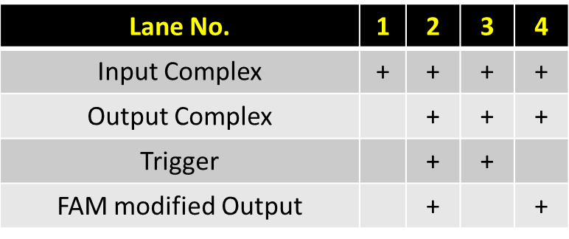
Input &Input*
Output &Output*
Output Strand with FAM
Output with FAM &Output*
Output &Output*
Output Strand
Fluorescence
Stained

Slide 50
Input &Input*
Output &Output*
Output Strand with FAM
Output with FAM &Output*
Output &Output*
Output Strand
Fluorescence
Stained

Slide 51
Lane2
Lane4

Slide 53
Rf Number [-] : 0.790
Band intensity [%] : 9.15 %
Lane 4
Rf Number [-] : 0.663
Band intensity [%] : 90.9 %

Slide 54
Lane 2
Rf Number [-] : 0.788
Band intensity [%] : 92.1 %
Rf Number [-] : 0.663
Band intensity [%] : 7.91 %

Slide 57
Rf Number [-] : 0.662609
Band intensity [%] : 7.908682
Rf Number [-] : 0.662609
Band intensity [%] : 90.85057
Rf Number [-] : 0.787826
Band intensity [%] : 92.091318
Rf Number [-] : 0.789565
Band intensity [%] : 9.149427

Slide 58
Lane 2
Lane 4
Rf Number [-] : 0.662609
Band intensity [%] : 7.908682
Rf Number [-] : 0.662609
Band intensity [%] : 90.85057
Rf Number [-] : 0.787826
Band intensity [%] : 92.091318
Rf Number [-] : 0.789565
Band intensity [%] : 9.149427

